Slide 1

ASP.NET Core Razor Pages
Razor Pages, Routing, Razor Class Libraries
SoftUni Team
Technical Trainers
Software University
http://softuni.bg

Slide 2
Table of Contents
Razor Pages
MVC vs Pages
Razor Pages Fundamentals
Razor Pages Filters
Razor Pages Routing
Route Constraints
Razor Class Libraries
Bundling and Minification
LibMan

Slide 3
Have a Question?
sli.do #csharp-web

Slide 4

@Razor
Razor Pages
Making page-focused scenarios easier to develop

Slide 5
Razor Pages
Apart from MVC, ASP.NET Core provides another approach
Enter Razor Pages! A Model-View-ViewModel-like framework
Razor Pages are similar to View Components
Model & Controller code is included in the Page itself
Enables two-way data binding and simpler development
Perfect for simple applications
With read-only functionality, or simple data input
The Single Responsibility is strong in this one

Slide 6

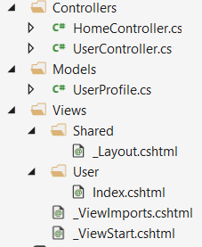
The MVC Approach
public class UserProfile
{
public string FirstName { get; set; }
public string LastName { get; set; }
}
@model UserProfile
<h1>Welcome</h1>
<p>Hey @Model.FirstName!</p>
public class UserController : Controller
{
public IActionResult Index()
{
// This would normally be extracted from the database
var model = new UserProfile
{
FirstName = "Jon",
LastName = "Hilton"
};
return base.View(model);
}
}

Slide 7
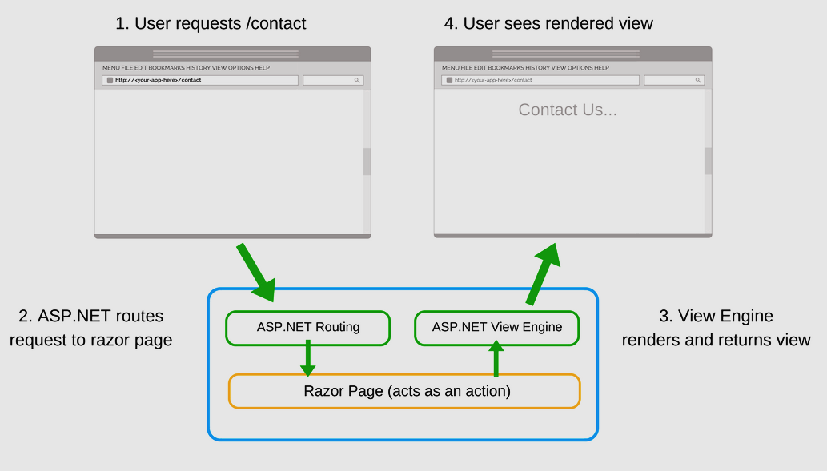
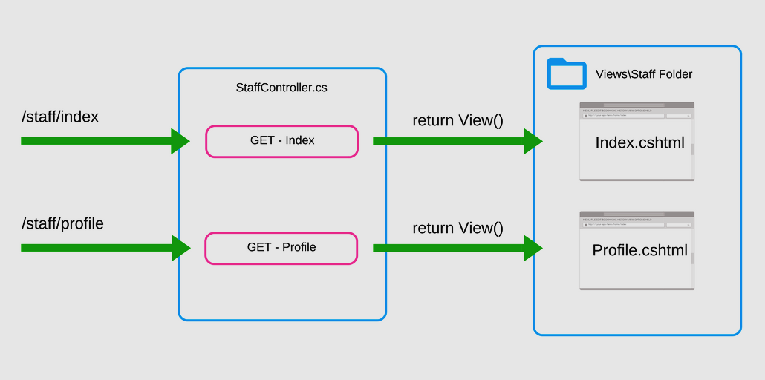
The MVC Approach
Request
Render View
StaffController
Views\Staff
Staff/Index
GET- Index
ASP.NET Routing
ASP.NET ViewEngine
ASP.NET routes request to controllers action
Staff/Profile
GET - Profile
Controller/Action

Slide 8
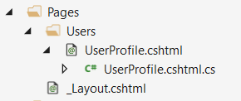
The Razor Pages Approach
public class UserProfileModel : PageModel
{
public string FirstName { get; set; }
public string LastName { get; set; }
public void OnGet()
{
// This would normally be extracted from the database
FirstName = "Jon";
LastName = "Hilton";
}
}
@page
@model UserProfileModel
<h1>Welcome</h1>
<p>Hey @Model.FirstName!</p>
Every Razor Page consists of:
A view template (.cshtml), which acts as a view
A functional (.cs) file, which acts as its controller action

Slide 9
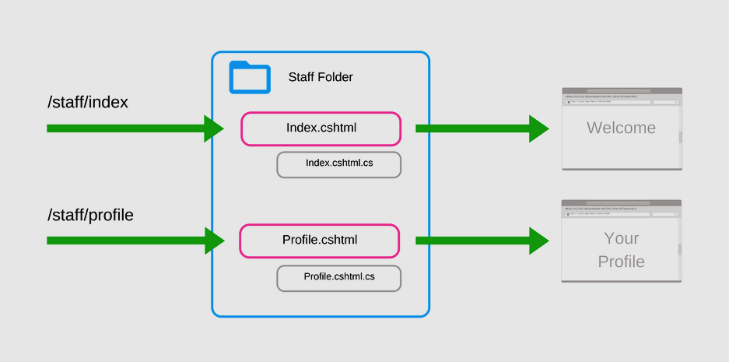
The Razor Pages Approach
Request
Render View
Staff Folder
Index.cshtml
Index.cshtml.cs
ASP.NET Routing
ASP.NET ViewEngine
ASP.NET routes request to razor page
Staff/Profile
Profile.cshtml
Razor Pages (acts as a action)
Profile.cshtml.cs

Slide 10
MVC vs Razor Pages
Razor Pages are simple and organized
Razor Pages makes Front-End structure more conventional
More explicit, less implicit
Razor pages are suitable for pure, page-oriented cases
About, contact, forms etc.
MVC is a bit more complex
Heavy architecture and code structure
MVC leaves a lot of freedom
For example, some actions may lack views named after them
MVC should be used for more MVC-ish cases:
APIs, SOA, Product Catalogs, etc.

Slide 11
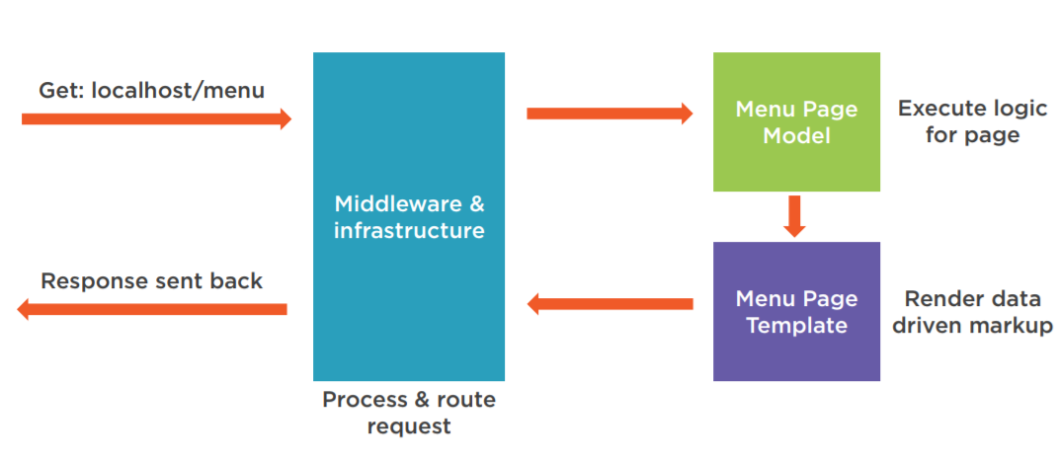
Razor Pages Request Pipeline

Slide 12


Razor Pages Form Submission
Razor Pages is very convenient for Form Data Submission
The logic is centralized in a single code component
public class UserProfileModel : PageModel
{
public string FirstName { get; set; }
public string LastName { get; set; }
public void OnGet()
{
// Run logic for loading the page and displaying it to the user
}
public void OnPost()
{
// Run logic for processing data submitted back to the Page Model
}
}

Slide 13
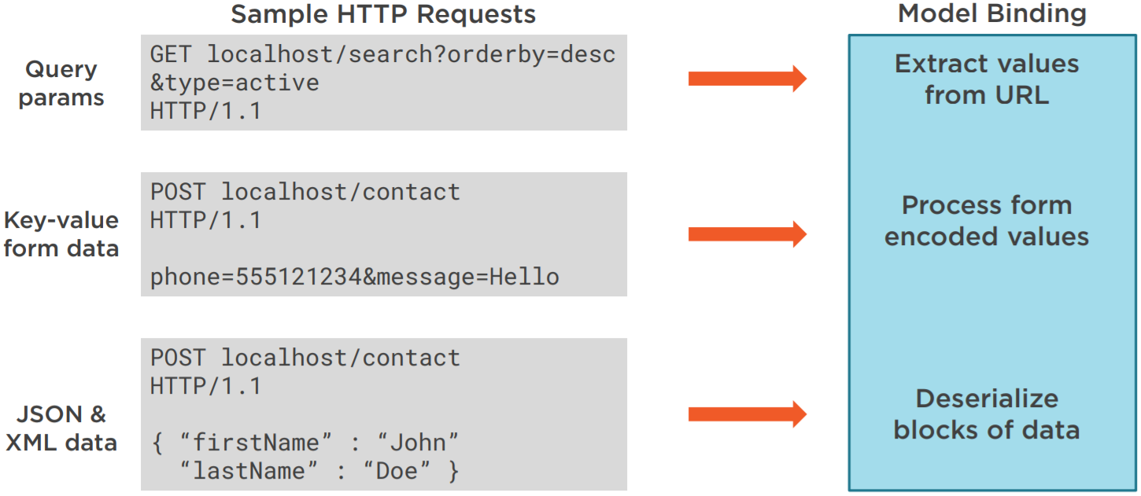
Razor Pages Form Submission
Handling request data and model binding is done differently
Depends on the context and the format of the data sent

Slide 14
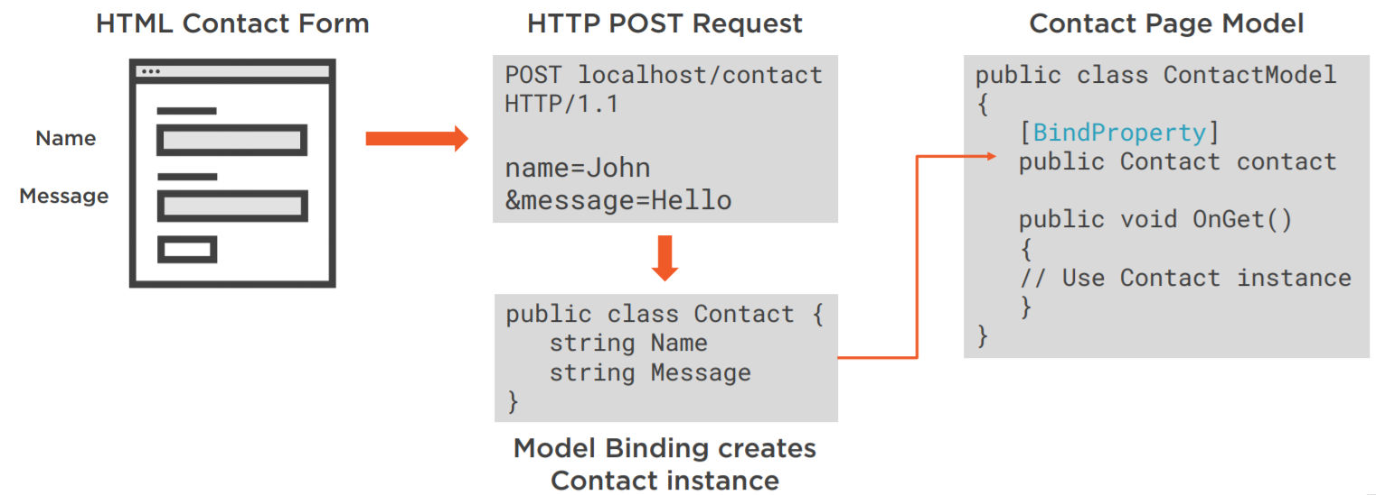
Razor Pages Form Submission
Binding Data in Razor Pages can be extracted into a separate model
As opposed to the previous examples with UserProfile
Where properties were stored in the Page's .cs file
[BindProperty] attribute is used to bind the foreign model to the model binding mechanism of the Page

Slide 15
SupportsGet Property
Allows properties to be bound on GET requests
Opt in to binding GET request data to page model properties
Verify user input before mapping it to properties
Opting in to GET binding is useful when addressing scenarios which rely on query string or route values
Bind a property on GET request
[BindProperty(SupportsGet = true)]

Slide 16

Razor Page Filters

Slide 17
Razor Page Filters
Razor Page filters IPageFilter and IAsyncPageFilter
Can't be applied to individual page, have access to HttpContext
Available methods for override
OnPageHandlerSelected After a handler (OnGet, OnPost) has been selected, before model binding
OnPageHandlerExecuting Before the handler executes, after model binding
OnPageHandlerExecuted After the handler executes, before the action result
OnPageHandlerSelectionAsync After the handler has been selected, but before model binding
OnPageHandlerExecutionAsync Before the handler is invoked, after model binding
ResultFilterAttribute, [Authorize], etc. are also available for pages

Slide 18
IAsyncPageFilter
public class CustomPageFilter : IAsyncPageFilter
{
public async Task OnPageHandlerSelectionAsync(PageHandlerSelectedContext context)
{
await Task.CompletedTask;
}
public async Task OnPageHandlerExecutionAsync(PageHandlerExecutingContext context,
PageHandlerExecutionDelegate next)
{
// ...
await next.Invoke();
}
}
services.AddMvc(options =>
{
options.Filters.Add(new CustomPageFilter());
});

Slide 19

Razor Page Routing Conventions

Slide 20
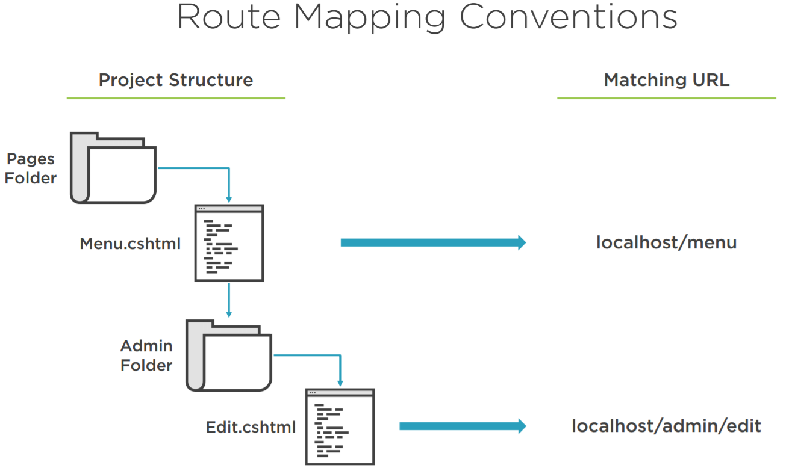
Razor Pages Routing
The Razor Pages conventional routing depends on the file structure

Slide 21
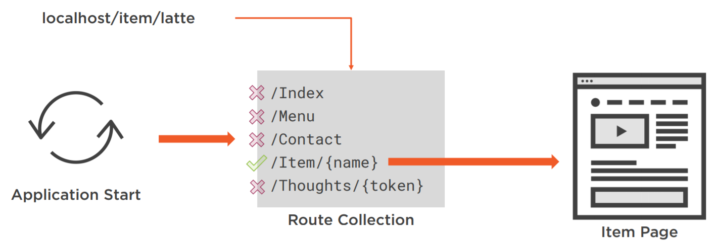
Razor Page Routing
Custom route templates are also an option in Razor Pages
@page "/users/profiles/{id}"
@model UserProfileModel
<h1>Welcome</h1>
<h1>Hey @Model.FirstName @Model.LastName!</h1>
The custom route template is passed after the @page
The custom route template can contain route parameters
NOTE: There are reserved route names, which you cannot use: "action","area","controller", "handler","page"

Slide 22
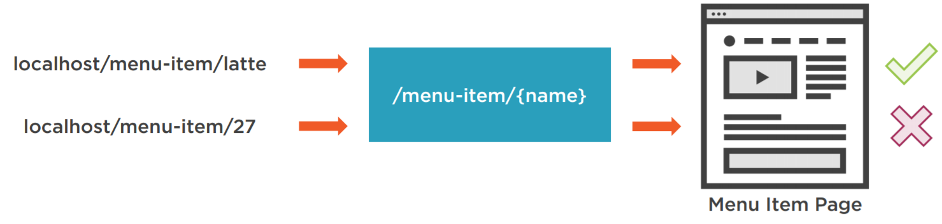
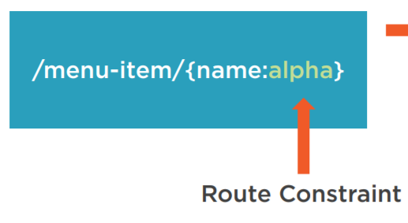
Razor Page Routing
You can also conventionalize the route parameters with your own rules
For example, we want our parameter to consist only of letters
Then we will use a route constraint
This will ensure our route parameters are in just the right format

Slide 23
Route Constraints
Here is a small reference of the most important route constraints
Route Constraint | Use | Example Matches
int | {id:int} | 123, -232, 5444, 10903
bool | {active:bool} | true, FALSE
decimal | {price:decimal} | -1,000.01, 49.90
guid | {id:guid} | CD2C1638-1638-72D5-…
minlength / maxlength | {filename:minlength(4)} / {filename:maxlength(8)} | file / file.db
minvalue / maxvalue | {age:min(18)} / {age:max(64)} | 19 / 63
length / range | {name:length(5,20)} / {age:range(18,64)} | File-of-base.db / 54
Alpha | {name:alpha} | Donald
regex | {sns:regex(^//d{{3,7}}$)} | 4567
required | {name:required} | Rick

Slide 24

RCL
Razor Class Libraries
Creating reusable UI

Slide 25
Razor Class Libraries
Razor components can be built into a Razor Class Library (RCL)
Razor Views, Pages, Controllers, Page Models
View Components, Data Models etc...
RCLs can be packaged and reused
Apps can include RCL and override views and pages it contains
There can be duplicate views, partials, pages etc.
In that case the Web App's component takes precedence
RCLs can be referenced through NuGet or project reference

Slide 26
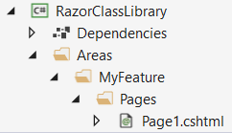
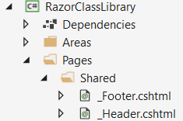

Razor Class Libraries
Razor Class Libraries are similar to ASP.NET Core Web apps by structure
It is recommended to put custom UI pieces to Areas
But you can also follow a default architecture
The second example is casually used to reference RCL content as it was part of the Web App’s Pages folder. Like an extension.
@Pages
You can see a Razor UI Class Library demo application here.

Slide 27
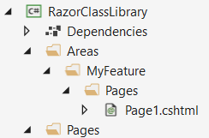
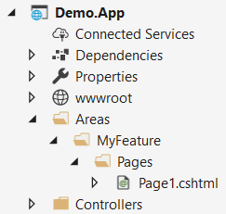
Razor Class Libraries
Razor Class Libraries content can be overridden pretty easily
As it was stated earlier, the app's components take precedence
In the event of a conflict (duplicate components)
We want to override this page in the RCL
The app's page is in the same area and takes precedence

Slide 28

Razor Class Libraries
Live Demonstration

Slide 29

Bundling and Minification
Bundle and minify static assets in ASP.NET Core

Slide 30
Bundling and Minification
Two distinct performance optimizations for applying in a web app
Used together, improve performance by
reducing the number of server requests
reducing the size of the requested static assets
Bundling
Combines multiple files into a single file (reducing server requests count)
Minification
Removes unnecessary characters from code without altering functionality
The result is a significant size reduction in requested assets

Slide 31
Bundling and Minification
bundleconfig.json defines the options for each bundle
Configuration options
outputFileName
inputFiles
minify
includeInProject
sourceMap
sourceMapRootPath
[
{
"outputFileName": "wwwroot/css/site.min.css",
"inputFiles": [
"wwwroot/css/site.css"
]
},
{
"outputFileName": "wwwroot/js/site.min.js",
"inputFiles": [
"wwwroot/js/site.js"
],
"minify": {
"enabled": true,
"renameLocals": true
},
"sourceMap": false
}
]

Slide 32

LibMan
Using LibMan with ASP.NET Core

Slide 33
LibMan
Library Manager (LibMan) is a lightweight, client-side library acquisition tool
Can be integrated in builds
Only the library files you need are downloaded
Additional tooling isn't necessary
Files can be placed in a specific location without resorting to build tasks or manual file copying
LibMan isn't a package management system

Slide 34
LibMan with ASP.NET Core
Add library files
From Add Client-Side Library
Manually in libman.json
Restore library files
libman.json
During build
Manually
{
"version": "1.0",
"defaultProvider": "unpkg",
"libraries": [
{
"library": "bootstrap@4.3.1",
"destination": "wwwroot/lib/bootstrap/",
"files": [
"dist/css/bootstrap.min.css",
"dist/js/bootstrap.min.js"
]
},
{
"library": "jquery@3.4.1",
"destination": "wwwroot/lib/jquery/",
"files": [
"dist/jquery.min.js"
]
}
]
}

Slide 35
LibMan with ASP.NET Core
Delete library files
clean operation
libman.json -> Clean Client-Side Libraries
Uninstall library files
libman.json -> libraries -> Uninstall…
Manually
Update library files
libman.json -> libraries -> Check for updates

Slide 36

Summary
Razor Pages
MVC vs Pages
Razor Pages Fundamentals
Razor Pages Filters
Razor Pages Routing
Route Constraints
Razor Class Libraries
Bundling and Minification
LibMan
…
…
…

Slide 37
https://softuni.bg/trainings/courses

Slide 38













SoftUni Diamond Partners

Slide 39




SoftUni Organizational Partners

Slide 40




Trainings @ Software University (SoftUni)
Software University – High-Quality Education and Employment Opportunities
softuni.bg
Software University Foundation
http://softuni.foundation/
Software University @ Facebook
facebook.com/SoftwareUniversity
Software University Forums
forum.softuni.bg

Slide 41

License
This course (slides, examples, demos, videos, homework, etc.) is licensed under the "Creative Commons Attribution-NonCommercial-ShareAlike 4.0 International" license

